Slide 1
2

Slide 2
Chapter Two
Company and Marketing Strategy
Partnering to Build Customer Relationships

Slide 3
Today’s Class Overview
Test I Overview
Open Floor (State of the Union Address)
Review of Last Class Lecture Marketing (1)
Strategy Lecture (2)
Five-Minute Drill (Positioning)
Mktg Environment (3)
Preview for Next Class
  Ch. 4 Mktg Info (first 20 minutes of class)
  Test 1 (last 60 minutes of class)

Slide 4
Test 1
Thursday (Last Hour of Class)
Covers Chapters 1-4, 200 Points
Take Six Tests, Drop Low One!
Multiple Choice Questions (150 Points)
  25 Questions @ 6 Points Each
  150 MC Points
Essay Questions (50 Points)
  Three Questions Given @ 25 Points Each
  Do Two Questions

Slide 5
Open Floor
State of the Union Address Tonight…
  President Obama’s Potential “Target Markets”
  Likely “Positioning” Utilized

Slide 6
Review of Last Class…

Slide 7
Chapter 1: Creating and Capturing Customer Value
What Is Marketing?
Understand the Marketplace and Customer Needs
Designing a Customer-Driven Marketing Strategy
Preparing an Integrated Marketing Plan and Program
Building Customer Relationships
Capturing Value from Customers
The Changing Marketing Landscape

Slide 8
Chapter Two
Company and Marketing Strategy
Partnering to Build Customer Relationships

Slide 9
Company and Marketing Strategy
Topic Outline
Companywide Strategic Planning: Defining Marketing’s Role
Designing the Business Portfolio
Planning Marketing: Partnering to Build Customer Relationships
Marketing Strategy and the Marketing Mix
Managing the Marketing Effort
Measuring and Managing Return on Marketing Investment

Slide 10

Companywide Strategic Planning
Strategic Planning
Strategic planning is the process of developing and maintaining a strategic fit between the organization’s goals and capabilities and its changing marketing opportunities
Question: What is a company that has good strategic planning?
Notes:
Note to Instructor
Strategic planning sets the stage for the rest of the planning in the firm.
In slideshow view, click on movie icon to launch Live Nation video snippet. See accompanying DVD for full video segment.
Discussion Question
How might the strategic plan of the college or university influence decisions in the schools programs and offerings. How might it influence decisions in food services, dormitories, executive education, and undergraduate versus graduate programs.

Slide 11
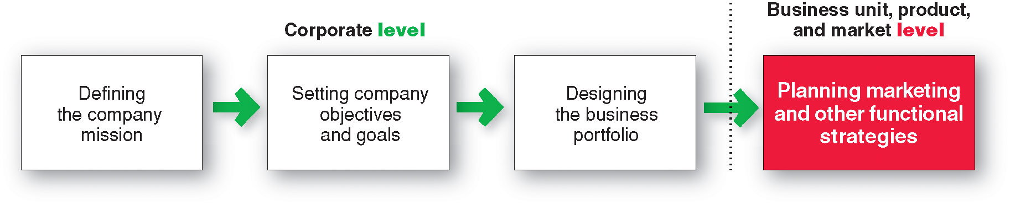
Companywide Strategic Planning
Steps in Strategic Planning

Slide 12

Companywide Strategic Planning
Defining a Market-Oriented Mission
The mission statement is the organization’s purpose, what it wants to accomplish in the larger environment
Market-oriented mission statement defines the business in terms of satisfying basic customer needs
We help you organize the world’s information and make it universally accessible and useful.
Notes:
Note to Instructor
A mission statement should:
Not be myopic in product terms
Meaningful and specific
Motivating
Emphasize the company’s strengths
Contain specific workable guidelines
Not be stated as making sales or profits

Slide 13
Companywide Strategic Planning
Company | Product-Oriented Definition | Market-Oriented Definition
Amazon.com | We sell books, videos, CDs, toys, consumer electronics and other products online | We make the Internet buying experience fast, easy, and enjoyable— we’re the place where you can find and discover anything you want to buy online
Disney | We run theme parks | We create fantasies—a place where dreams come true and America still works the way it’s supposed to
Nike | We sell athletic shoes and apparel | We bring inspiration and innovation to every athlete* in the world (* if you have a body, you are an athlete)

Slide 14
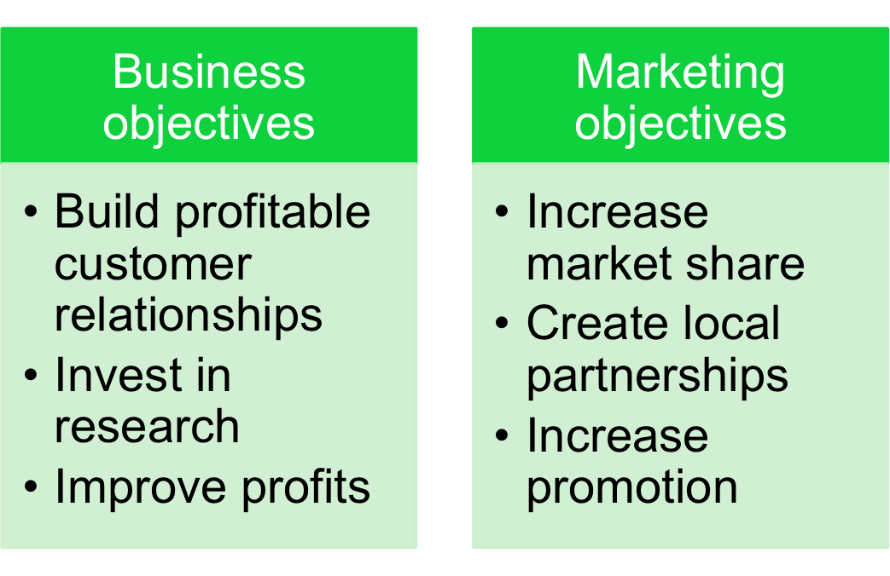
Companywide Strategic Planning
Setting Company Objectives and Goals

Slide 15
Companywide Strategic Planning
Designing the Business Portfolio
The business portfolio is the collection of businesses and products that make up the company
Portfolio analysis is a major activity in strategic planning whereby management evaluates the products and businesses that make up the company

Slide 16

Companywide Strategic Planning
Analyzing the Current Business Portfolio
Strategic business unit (SBU) is a unit of the company that has a separate mission and objectives that can be planned separately from other company businesses
Company division
Product line within a division
Single product or brand
Notes:
Note to Instructor
This Web link is to Procter & Gamble is an interesting site to explore with the students. Click on the Family of products.
Discussion Question
Which product categories might be growing markets, slower markets, and emerging markets. This site can be explored again when viewing Figure 2.2—the BCG grid.

Slide 17
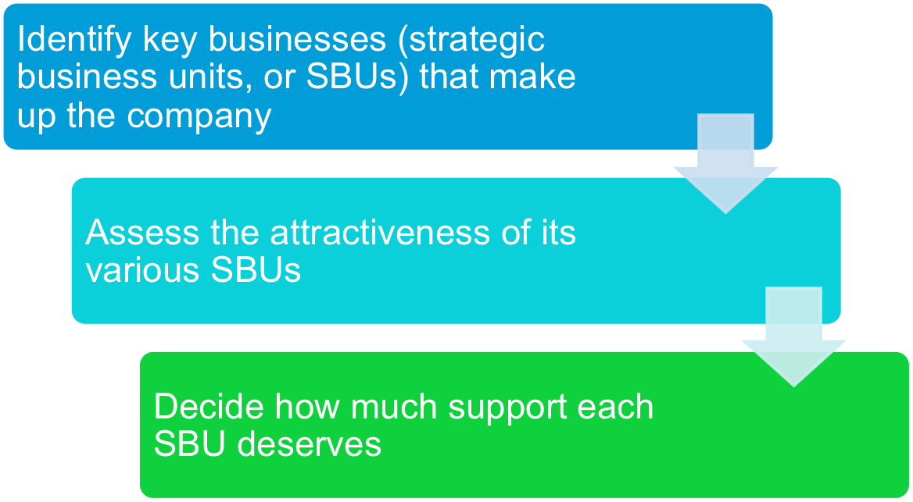
Companywide Strategic Planning
Analyzing the Current Business Portfolio

Slide 18
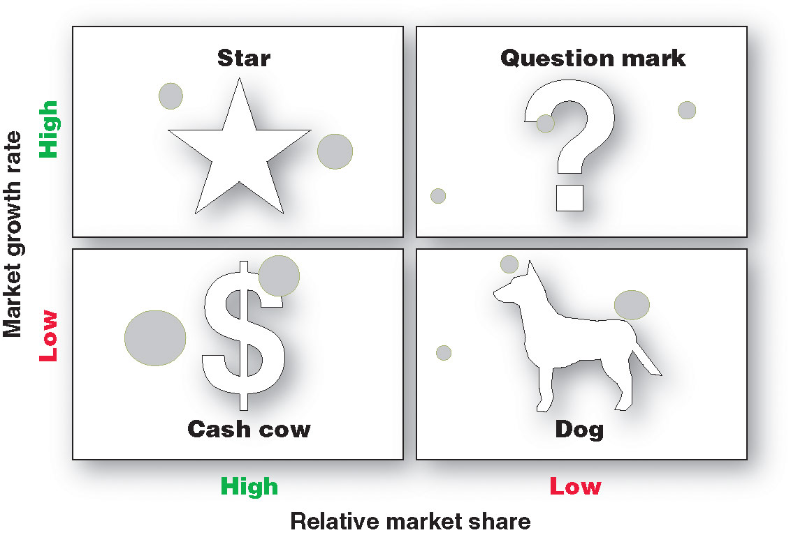
Companywide Strategic Planning:
Notes:
Note to Instructor
Stars are high-growth, high-share businesses or products requiring heavy investment to finance rapid growth. They will eventually turn into cash cows.
Cash cows are low-growth, high-share businesses or products that are established and successful SBUs requiring less investment to maintain market share.
Question marks are low-share business units in high-growth markets requiring a lot of cash to hold their share.
Dogs are low-growth, low-share businesses and products that may generate enough cash to maintain themselves but do not promise to be large sources of cash.

Slide 19
Companywide Strategic Planning
Problems with Matrix Approaches
Difficulty in defining SBUs and measuring market share and growth
Time consuming
Expensive
Focus on current businesses, not future planning

Slide 20
Companywide Strategic Planning
Developing Strategies for Growth and Downsizing
Product/market expansion grid is a tool for identifying company growth opportunities through market penetration, market development, product development, or diversification

Slide 21
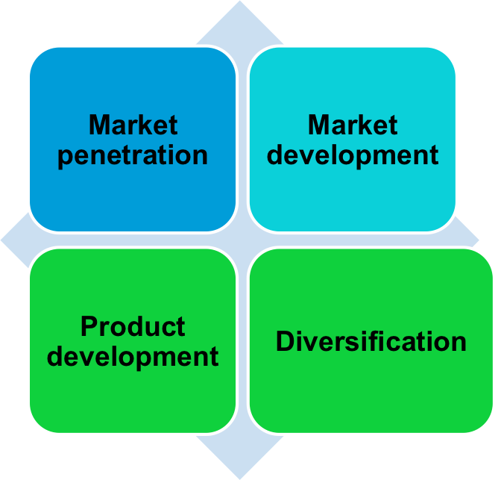

Companywide Strategic Planning
Developing Strategies for Growth and Downsizing Product/Market Expansion Grid Strategies

Slide 22
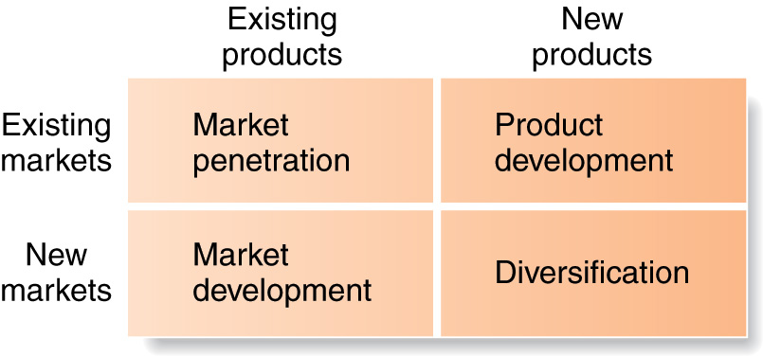
Companywide Strategic Planning
Developing Strategies for Growth and Downsizing
Product/market expansion grid strategies

Slide 23
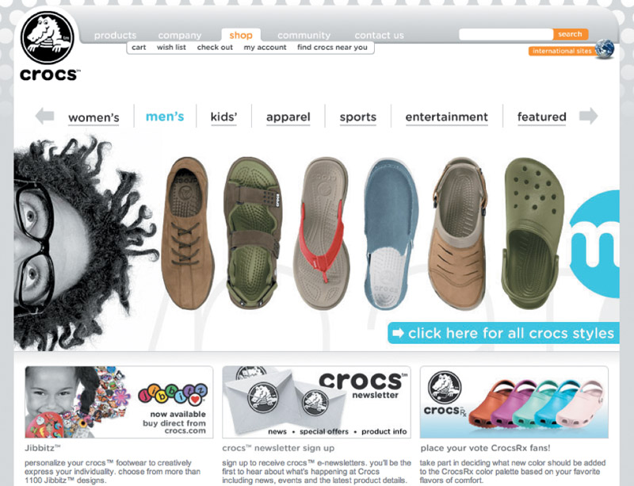
Companywide Strategic Planning
Developing Strategies
for Growth and Downsizing
Market penetration is a growth strategy increasing sales to current market segments without changing the product
Market development is a growth strategy that identifies and develops new market segments for current products

Slide 24
Companywide Strategic Planning
Developing Strategies
for Growth and Downsizing
Product development is a growth strategy that offers new or modified products to existing market segments
Diversification is a growth strategy through starting up or acquiring businesses outside the company’s current products and markets
Notes:
Note to Instructor
This Web link leads to the hompage for Virgin. This is a great company to discuss as they provide examples of market development, product development and diversification. Their homepage lists all their industries and products including tourism, leisure, shopping, media, finance, and healthcare.

Slide 25
Companywide Strategic Planning
Developing Strategies
for Growth and Downsizing
Downsizing is the reduction of the business portfolio by eliminating products or business units that are not profitable or that no longer fit the company’s overall strategy

Slide 26

Planning Marketing
Partnering to Build Customer Relationships
Value chain is a series of departments that carry out value-creating activities to design, produce, market, deliver, and support a firm’s products

Slide 27
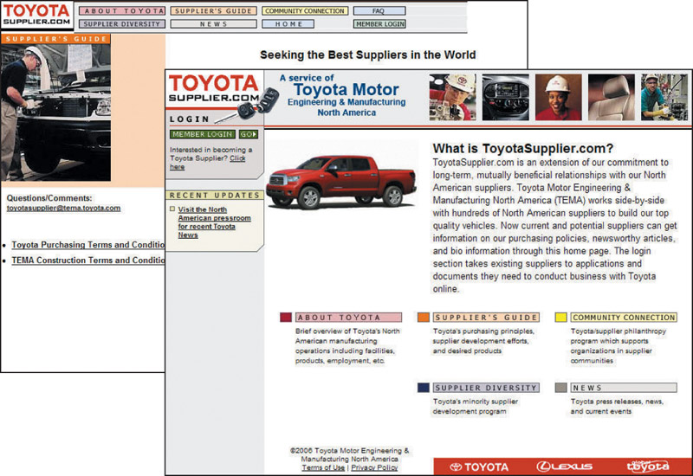
Planning Marketing
Partnering to Build Customer Relationships
Value delivery network is made up of the company, suppliers, distributors, and ultimately customers who partner with each other to improve performance of the entire system

Slide 28
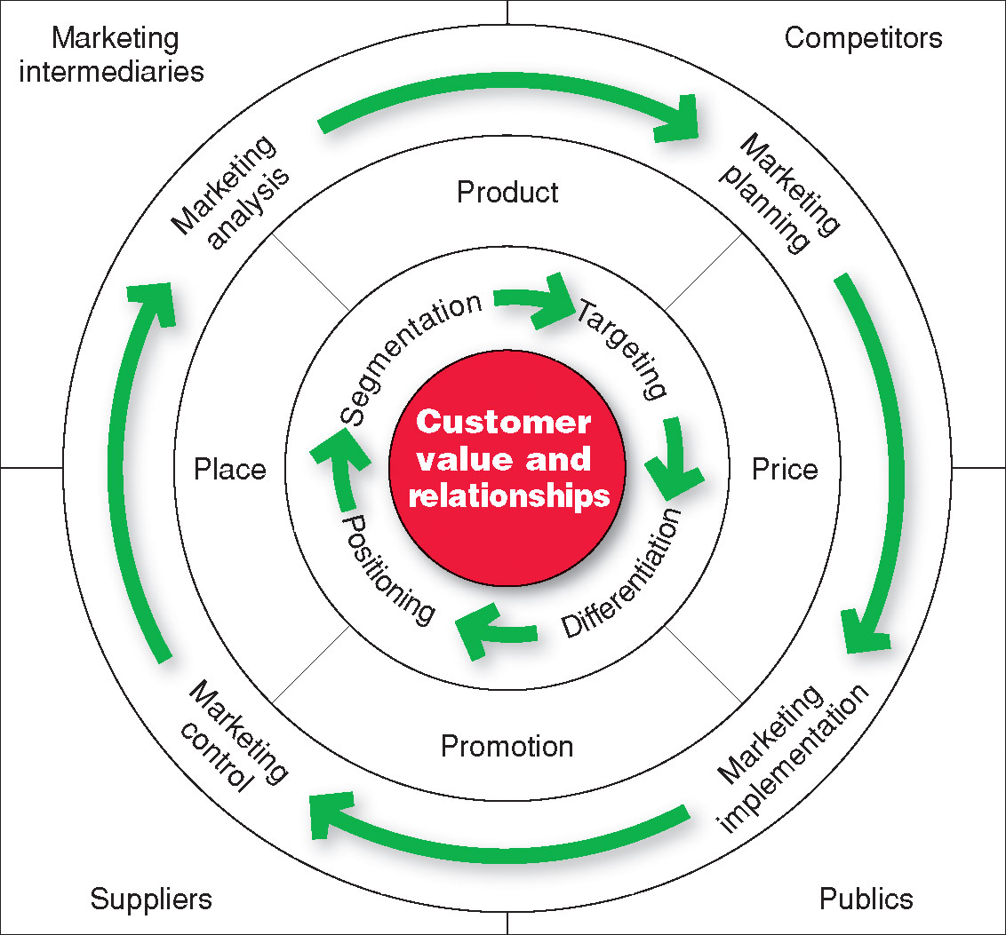
Marketing Strategy and the Marketing Mix
Notes:
Note to Instructor
Consumers stand in the center. The goal is to create value for customers and build profitable customer relationships. Next comes marketing strategy—the marketing logic by which the company hopes to create this customer value and achieve these profitable relationships. The company decides which customers it will serve (segmentation and targeting) and how (differentiation and positioning). It identifies the total market, then divides it into smaller segments, selects the most promising segments, and focuses on serving and satisfying the customers in these segments. Guided by marketing strategy, the company designs an integrated marketing mix made up of factors under its control—product, price, place, and promotion (the four Ps). To find the best marketing strategy and mix, the company engages in marketing analysis, planning, implementation, and control. Through these activities, the company watches and adapts to the actors and forces in the marketing environment.

Slide 29
Marketing Strategy and the Marketing Mix
Customer-Driven Marketing Strategy
Market segmentation is the division of a market into distinct groups of buyers who have distinct needs, characteristics, or behavior and who might require separate products or marketing mixes
Market segment is a group of consumers who respond in a similar way to a given set of marketing efforts

Slide 30
Marketing Strategy and the Marketing Mix
Customer-Centered Marketing Strategy
Market targeting is the process of evaluating each market segment’s attractiveness and selecting one or more segments to enter
Notes:
Note to Instructor
This link goes to the nike.com site. Explore with the students the different segments including gender Nike Women, psychographics (sports centric including football), and age.
Discussion Questions (can include the topic of positioning which is on the following slide).
Specific questions for the students:
How does Nike segment their market?
What appears to be their most important segments?
How does Nike position their products in the marketplace?

Slide 31
Marketing Strategy and the Marketing Mix
Customer-Centered Marketing Strategy
Market positioning is the arranging for a product to occupy a clear, distinctive, and desirable place relative to competing products in the minds of the target consumer

Slide 32
Five-Minute Drill
Select a Company…
Identify…
  a Specific Product
  The Target Customer for the Product
  The Positioning of the Product

Slide 33
Marketing Strategy and the Marketing Mix
Developing an Integrated Marketing Mix
Marketing mix is the set of controllable tactical marketing tools—product, price, place, and promotion—that the firm blends to produce the response it wants in the target market

Slide 34
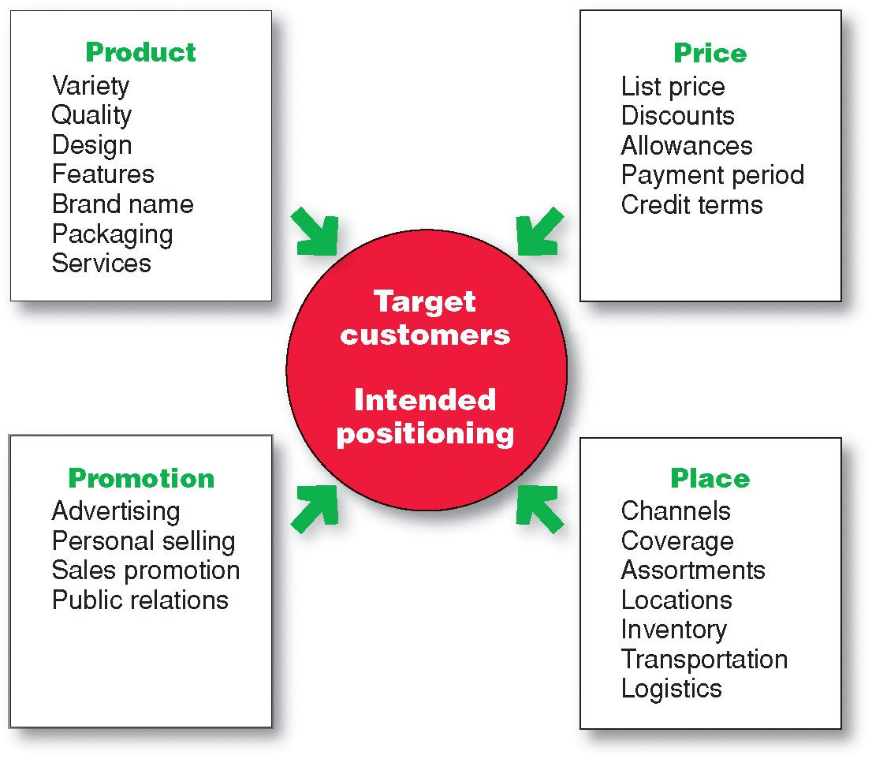
Marketing Strategy and the Marketing Mix
Developing an Integrated Marketing Mix
Notes:
Note to Instructor
It is interesting to ask how to make the 4Ps more customer centric? This leads to a redefining of the 4Ps to the 4Cs as follows:
Product—Customer solution
Price—Customer cost
Place—Convenience
Promotion—Communication

Slide 35
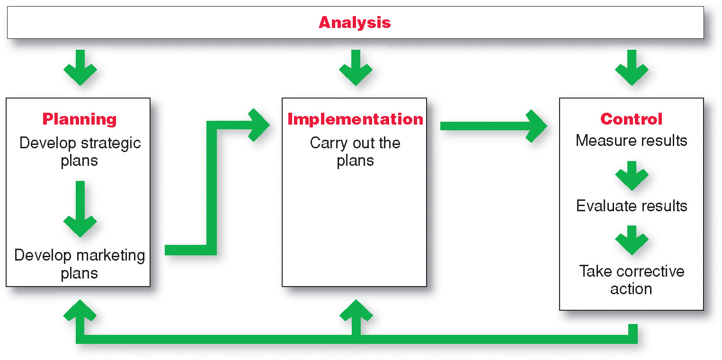
Managing the Marketing Effort

Slide 36
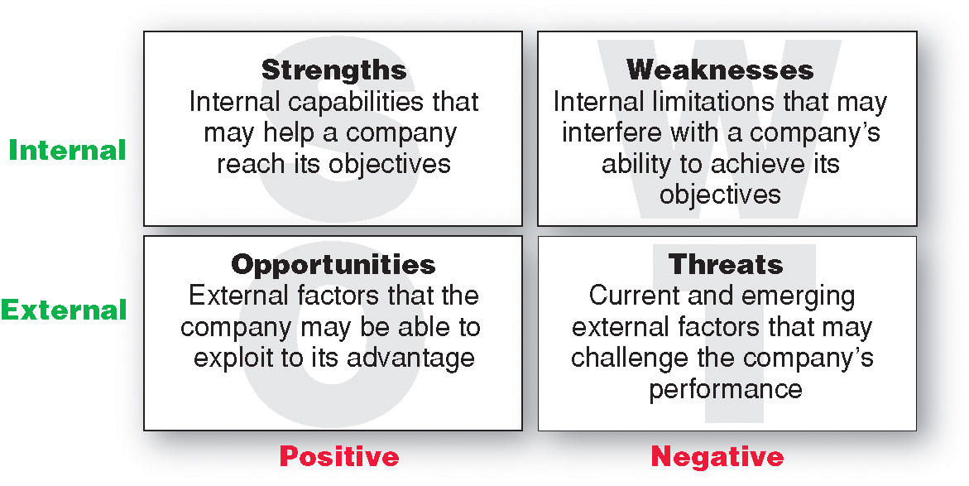
Managing the Marketing Effort
Marketing Analysis – SWOT Analysis

Slide 37
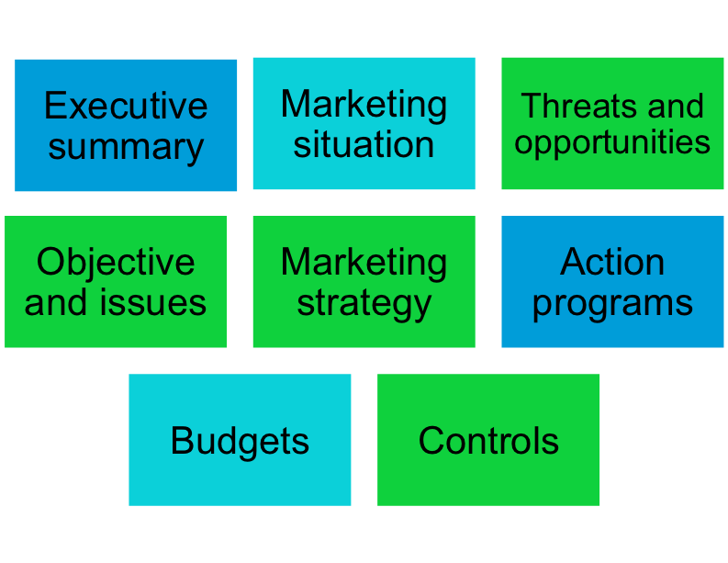

Managing the Marketing Effort
Market Planning—Parts of a Marketing Plan

Slide 38
Managing the Marketing Effort
Marketing Implementation
Implementing is the process that turns marketing plans into marketing actions to accomplish strategic marketing objectives
Successful implementation depends on how well the company blends its people, organizational structure, decision and reward system, and company culture into a cohesive action plan that supports its strategies

Slide 39
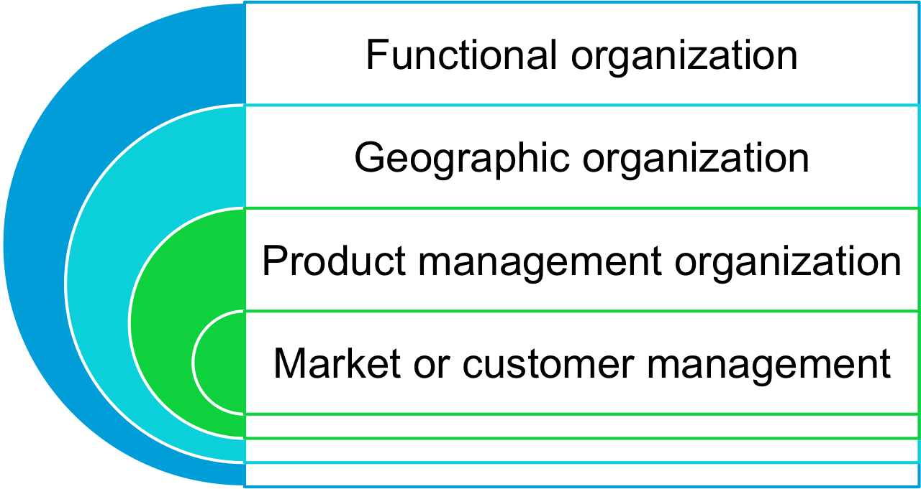
Managing the Marketing Effort
Marketing Department Organization
Notes:
Note to Instructor
Functional organization: This is the most common form of marketing organization with different marketing functions headed by a functional specialist.
Geographic organization: Useful for companies that sell across the country or internationally. Managers are responsible for developing strategies and plans for a specific region.
Product management: Useful for companies with different products or brands. Managers are responsible for developing strategies and plans for a specific product or brand.
Market or customer management organization: Useful for companies with one product line sold to many different markets and customers. Managers are responsible for developing strategies and plans for their specific markets or customers.
Customer management involves a customer focus and not a product focus for managing customer profitability and customer equity.

Slide 40
Managing the Marketing Effort
Marketing Control
Controlling is the measurement and evaluation of results and the taking of corrective action as needed
Operating control
Strategic control
Notes:
Note to Instructor
Operating control involves checking ongoing performance against an annual plan and taking corrective action as needed.
Strategic control involves looking at whether the company’s basic strategies are well matched to its opportunities.

Slide 41

Measuring and Managing
Return on Marketing Investment
Return on Marketing Investment (Marketing ROI)
Return on marketing investment (Marketing ROI) is the net return from a marketing investment divided by the costs of the marketing investment. Marketing ROI provides a measurement of the profits generated by investments in marketing activities.

